Slide 1
Project Title : Sales Forecasting System – PredictX
SEC : MCA-B
Subject : JAVA
Presented By : AKBARHUSAIN
Notes:
‹#›

Slide 2
📜 History of Java
Java was developed by James Gosling at Sun Microsystems in 1995. It was designed to be platform-independent, secure, and simple for building cross-platform applications. It later became a part of Oracle Corporation.
⚙️ Real-time Applications
Enterprise-level software (e.g., banking, ERP systems)
Android mobile applications
Web-based applications
Embedded systems and IoT
Scientific computing and simulations
Notes:
‹#›

Slide 3
Advantages
Platform Independent (Write Once, Run Anywhere)
Object-Oriented Programming
Robust memory management and security
Multithreading support for high performance
⚠️ Disadvantages
Slower compared to native languages like C++
GUI development with Swing/JavaFX can be complex
Higher memory usage
Notes:
‹#›

Slide 4
PROBLEM STATEMENT
Inaccurate forecasts result in inventory mismanagement, leading to $50K annual losses.
Inefficient resource allocation hinders productivity.
Missed sales opportunities impact revenue growth.
Notes:
‹#›

Slide 5
📉 Challenges in Sales Prediction
Manual forecasting methods are time-consuming, error-prone, and often lack accuracy due to dynamic market trends.
🤖 Need for Automation
Businesses require an intelligent system that can automatically analyze historical data, predict future sales, and assist in data-driven decision-making.
Notes:
‹#›

Slide 6

PredictX: Revolutionizing Sales Forecasting
The Sales Forecasting System aims to predict product sales based on store and item codes using machine learning and provide real-time recommendations to support inventory and discount strategies.
Notes:
‹#›

Slide 7





Technology Stack: Java & Modern Web
Backend
Frontend
MySQL Database
Machine Learning
Java (Core Java, File I/O, Collections, and Custom ML Logic)
HTML, CSS, JavaScript for interactive and responsive UI
Efficient data storage, retrieval, and management
Custom ML model implemented in Java for sales prediction using regression algorithms
Notes:
‹#›

Slide 8
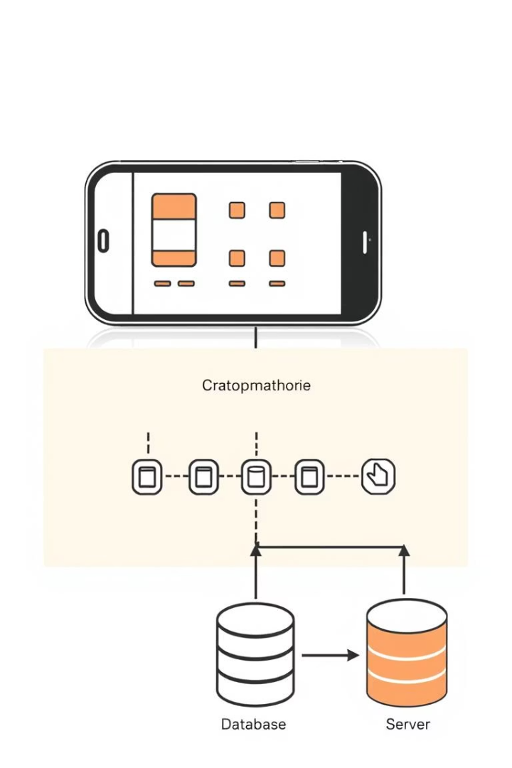
Core Modules & System Architecture
Data Input Module
Facilitates sales data upload and processing for analysis.
Forecasting Module
Trains ML models and generates sales predictions.
Reporting Module
Visualizes sales forecasts through charts and reports.
User Management Module
Controls access and permissions within the system.
Notes:
‹#›

Slide 9
Database Design & Folder Structure
Database Design
Folder Structure
The system is structured around key relational tables to support efficient sales forecasting and data management:
src/Predictx/
Contains all the core Java source code including backend logic, ML prediction classes, controllers, and service layers.
Sales_Data – Stores transactional records including store code, item code, quantity sold, and date.
src/resources
Stores configuration files such as database connection properties, logging configurations, and ML model settings if needed.
Products – Contains product details such as item code, name, and category.
Customers – Holds customer information for personalized recommendations.
src/main/webapp
Includes all frontend components like HTML, CSS, and JavaScript files used to create a user-friendly UI and dashboard.
Forecasts – Stores predicted sales data, timestamped for traceability and decision-making.
Notes:
‹#›

Slide 10
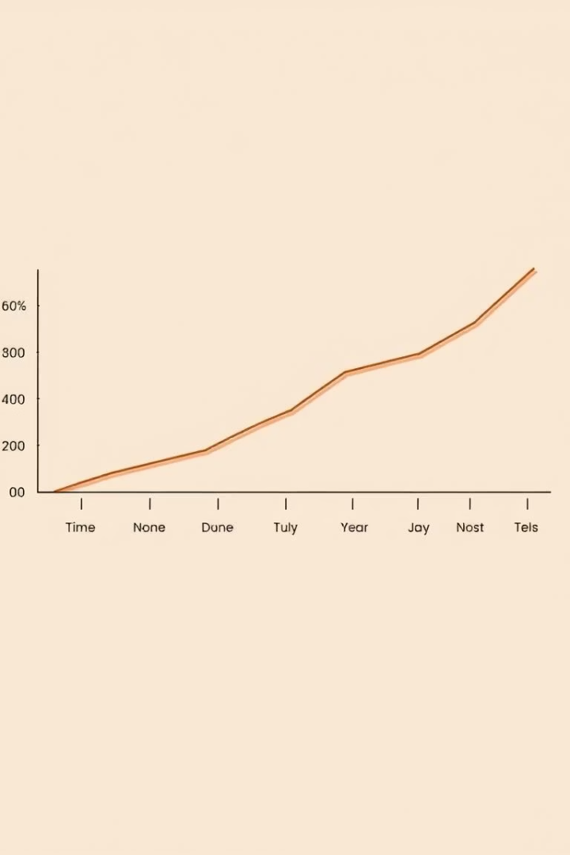




Forecasting Algorithm
Model Type
A linear regression model is used for predicting sales trends over time based on storeCode, itemCode, and sales history.
Parameter Tuning
Parameters like sales window size and feature weighting are tuned manually within the Java logic to improve prediction accuracy.
Evaluation Metric
Model performance is evaluated using Mean Absolute Error (MAE) during testing phases to maintain prediction reliability.
Notes:
‹#›

Slide 11
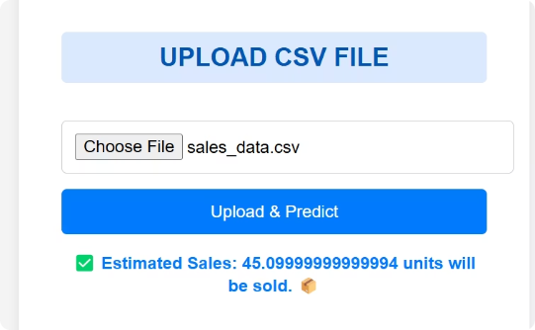
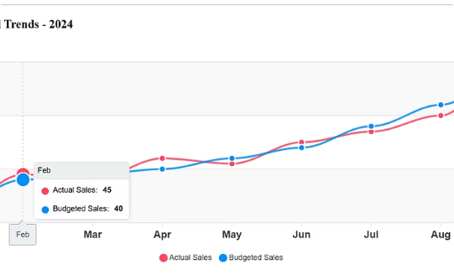
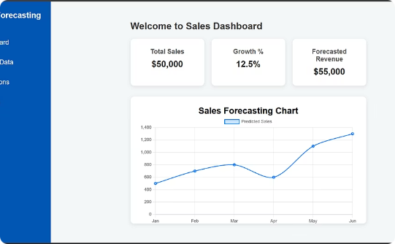
UI/Prediction Screenshots & Key Features
Data Input Module
Forecasting Module
Reporting Module
Easy uploading of sales data for processing.
Viewing sales predictions in tables and charts.
Interactive sales dashboard for insights.
Notes:
‹#›

Slide 12



Addressing Key Challenges
Data Quality
Inconsistent data formats are validated and cleaned.
Model Accuracy
Predictions are improved through retraining and tuning.
Scalability
Large datasets are handled via database optimization.
Notes:
‹#›

Slide 13
Conclusion & GitHub Link
Summary of Project Impact
Successfully developed a Real-Time Sales Forecasting System integrated with a Recommendation Engine.
Enhanced business decision-making by predicting future sales trends using machine learning.
Implemented a seamless UI using HTML, CSS, and JavaScript, connected to a Java backend with a MySQL database.
Replaced traditional file upload with a real-time dashboard for better user experience and live predictions.
GitHub Repository
🔗 https://github.com/Akbarhusain12/Sales_Prediction_Java
Notes:
‹#›

